Slide 1
Simon Types
Lab Training Embedded Systems SS2018
July 2018
By
Bindushree Heresave Balasubramanya
Samuel Thanuvelil Thomas
Subhomoy Mukherjee
TU Ilmenau

Slide 2
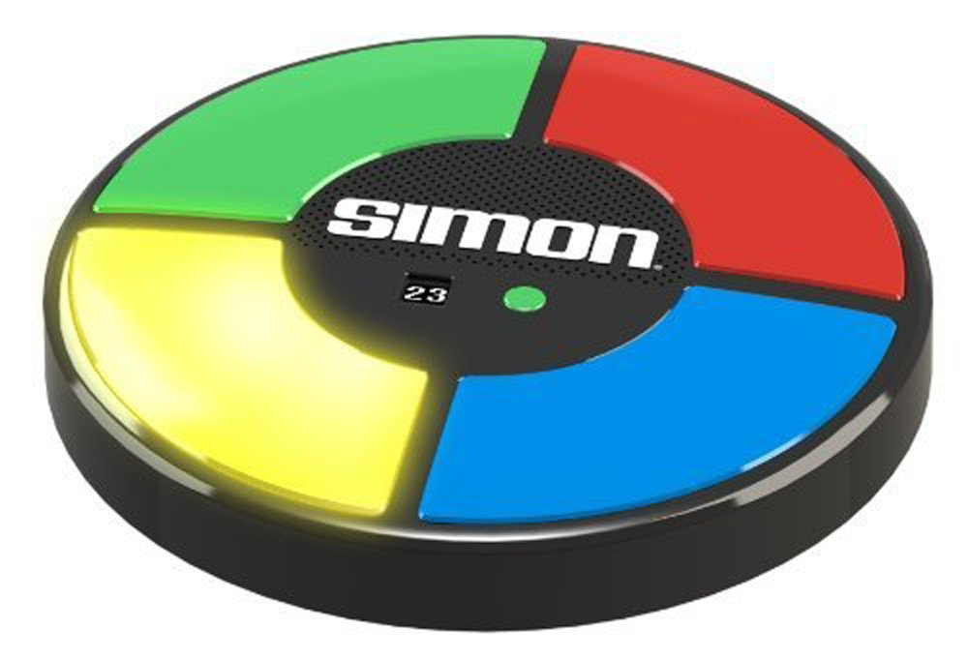
Introduction
Simon Games
Memory Game
“Tones and Lights”
Simon Types
Difference

Slide 3
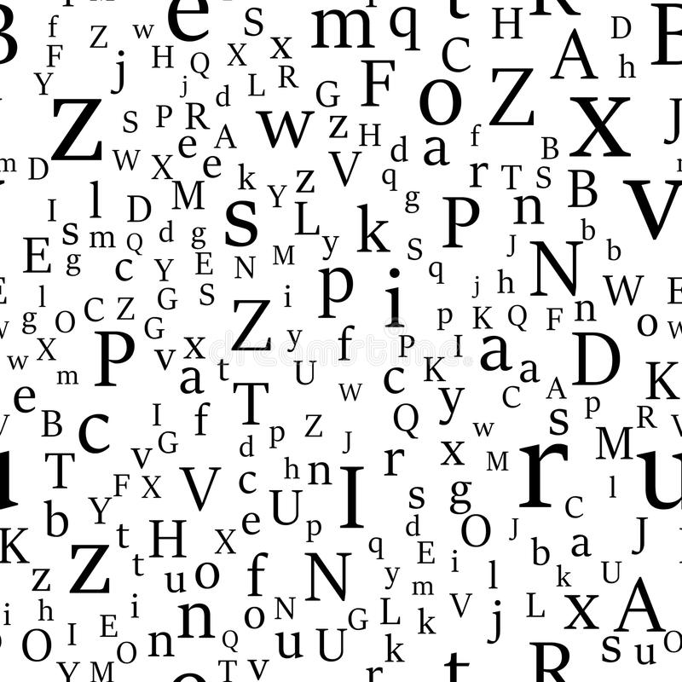
Simon Types
Non-music Game
Memory Game
Random Characters
Limited Time
Level oriented
Increasing difficulty

Slide 4
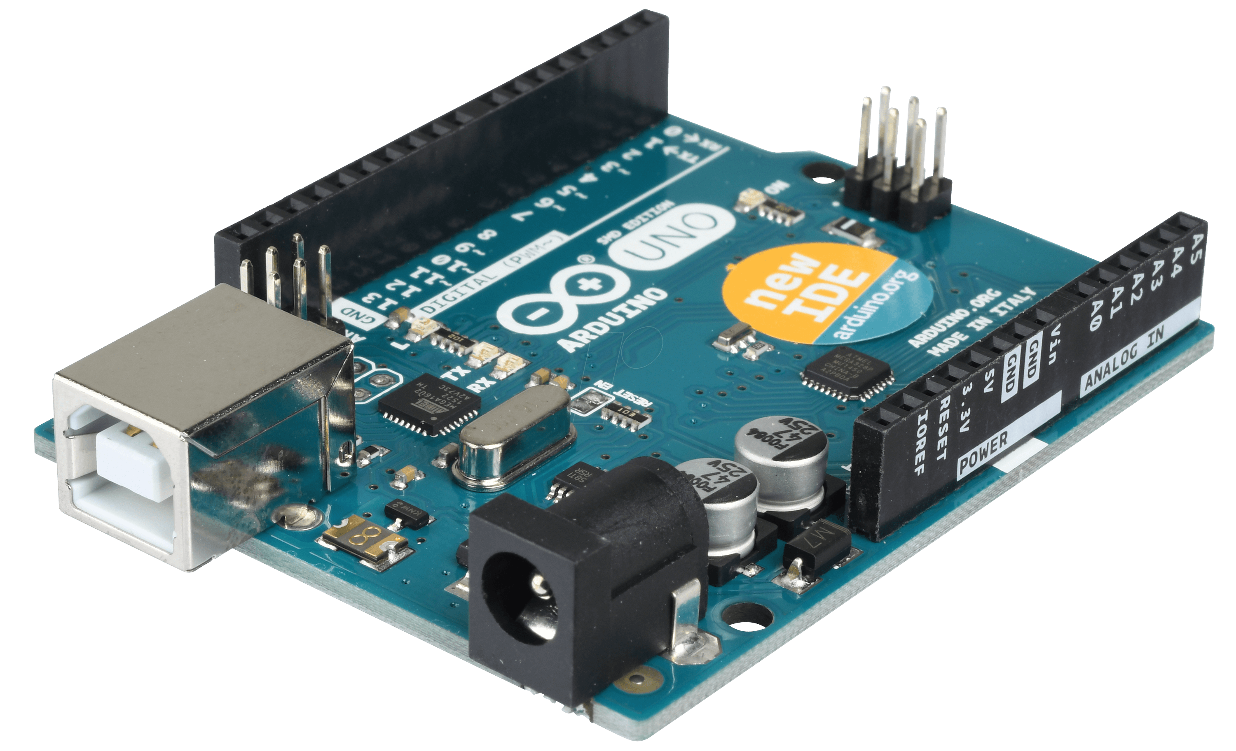
Hardware Requirements
Arduino Uno
LCD Screen (MI0283QT)
Jumper wires x 4
Breadboard
PS2 Keyboard

Slide 5
Implementation
“Press Enter to Start” displayed until the “Enter Key” is pressed
“Select Level 1 to 5” displayed until input is received from: 1 – 5
Initial score set to 0
Random sequence with (level + 4) characters displayed for 2 seconds
Sequence hidden, player to input the characters
Correct sequence increments the score by 1 else “Game Over” with Score
Levels: If score is a multiple of 5, increase in level

Slide 6
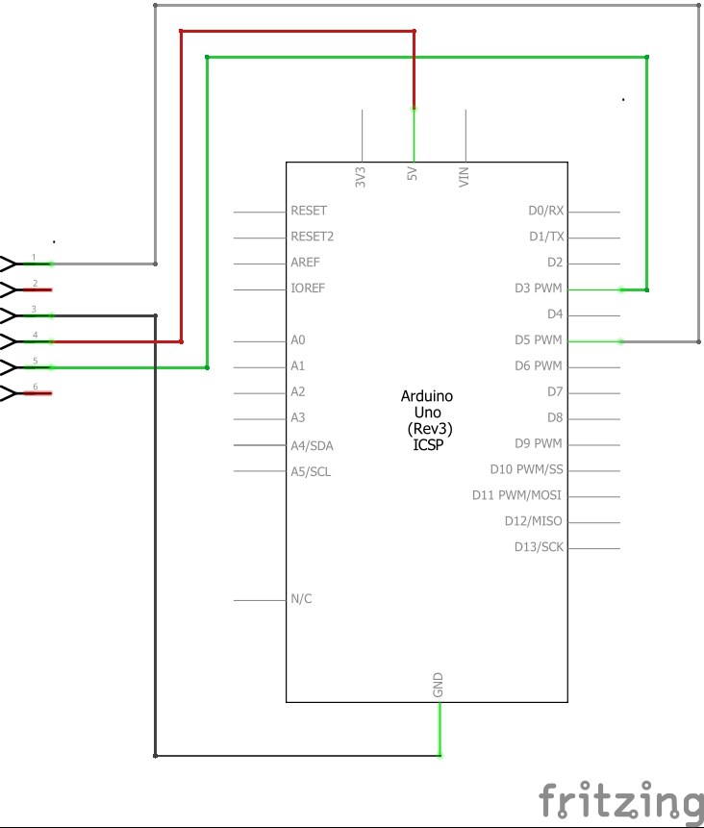
Schematics

Slide 7
Demonstration

Slide 8
Simon Types
Lab Training Embedded Systems SS2018
July 2018
By
Bindushree Heresave Balasubramanya
Samuel Thanuvelil Thomas
Subhomoy Mukherjee
TU Ilmenau

